Slide 1
innovation strategy in r&D projects: a step by step guide
Available at:
http://health2market.eu/results/step-by-step-guide
Appendix 1:
Indicative template for patent analysis
DISCLAIMER: Health-2-Market project has been financed by the European Commission under the grant agreement N° 305532. This document reflects only the view of the author(s) and the European Commission cannot be held responsible for any use which may be made of the information contained herein. This document is provided for informational purpose only and “as is”, with no guarantees or warranties whatsoever, including any warranty of merchantability, non-infringement, fitness for any particular purpose, or any other warranty with respect to any information, result, proposal, specification or sample contained or referred to herein. Any liability, including liability for infringement of any proprietary rights, regarding the use of this document or any information contained herein is disclaimed. No license, express or implied, by estoppel or otherwise, to any intellectual property rights is granted by or in connection with this document. This document is subject to change without notice. Copyright 2015 by Health-2-Market consortium.

Slide 2
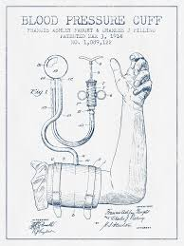
Why should I patent my innovation?
Patents
A patent is a set of exclusive rights granted by a sovereign state to an inventor or assignee for a limited period of time in exchange for detailed public disclosure of an invention. Patents confer the right to prevent third parties from making, using or selling the innovation without their owners' consent. If you do not protect your intellectual property, others will be able to use your innovation and potentially profit from it.
Why should I patent my innovation?
Whether it is a scientific discovery, new process, product design, invention or apparatus, your innovation may be intellectual property (IP) that has economic value. Intellectual property can include the innovations and other creative expressions of your ideas that you created. Therefore, you can and should pursue legal protection of your inventions by filing a patent.
Patents can be extremely powerful business tools and are necessary for any commercialization endeavor. Patents normally have a lifetime of 20 years and during this time the intellectual property is the sole property of the owner.

Slide 3
How can I identify and protect my IP?
To figure out whether your new invention, product or process is unique and qualifies for patent protection, begin by asking yourself these simple questions:
✓ Is it novel or unique?
✓ Is it non-obvious?
✓ Is it industrially applicable?
If your initial answer to all three questions is yes, there is a good chance that your invention is patentable. The next step is to evaluate your assumptions by conducting a patent search and comparing your results to the state of the art.

Slide 4
Approach for the patent analysis
AIM
Examination of the patentability of ____________________________________________
APPROACH
1.
Evaluation of the invention
2.
Application strategy
3.
IP concept
Type of the invention
Novelty of the invention
Inventive steps
Patent holders
Priority application: SP, EP or USA, etc.
Countries to protect
Summary IP strategy

Slide 5
IP Protection Process Overview
First Step
Second Step
Third Step
Fourth Step
Analysis to determine novelty and inventive steps, identify other patent holders and countries where similar patents are protected
Summary of analysis can be used as basis for filing patent(s) as well as for informing your patent nationalization strategy
Keyword search of publications and patent databases
01
Compare search results with described invention or innovation
02
03
04

Slide 6
01
Evaluation of the invention
First Step: Keyword Search
Keyword Search
Search in patent databases and publications for key words related to your innovation.
Documentation and keywords may have been prepared for other uses that can be valuable in patent search and analysis. For example, journal articles, papers and theses, invention disclosures, grant applications, and research notes could all be useful.
Where to search for patent analysis:
USPTO databases – patft.uspto.gov/
Google Patents – www.google.com/patents
Espacenet – ep.espacenet.com/
Patentscope.wipo – https://patentscope.wipo.int
Pubmed – http://www.ncbi.nlm.nih.gov/pubmed
World Intellectual Property Organization - http://www.wipo.int/patentscope/search/en
Or another search engine

Slide 7
01
Evaluation of the invention
First Step: Keyword Search Results
Compile and tabulate search resuLTs
You can compile your search results in a tabulated spreadsheet. Most patent search databases will allow you to export your search results. We recommend to export such information as:
title of patent,
publication number,
publication date,
priority date,
inventor,
applicant,
patent type,
and protected country or countries.
This will not only organize your search results for future reference but more importantly, compare and analyse your patent search results.

Slide 8
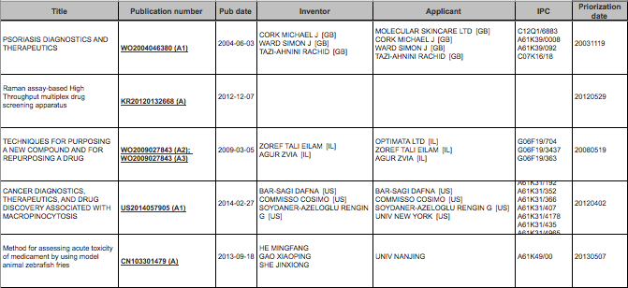
01
Evaluation of the invention
First Step: Keyword Search
SEMANTICAL SIMILAR PATENTS
Example

Slide 9
01
Evaluation of the invention
First Step: Keyword Search
Explanation of International patent classification (IPC)
The International Patent Classification (IPC) provides for a hierarchical system of language independent symbols for the classification of patents and utility models according to the different areas of technology to which they pertain.
IPC | Explanation of the IPC
G01N33/50 | Investigating or analysing biological material by chemical analysis
Patent Classification
G
01
N
33/50
Patent attorneys provide expertise and strategic guidance on what the best IPC is to file under based on:
Invention information
Categories of subject matter
Additional information
Section – 1st level
G PHYSICS
Subgroup - lower level
Class – 2nd level
Subclass – 3rd level
Group
G01N33/50
Investigating or analysing biological material by chemical analysis
Definition statement
This group covers:
Chemical analysis of biological material, e.g blood (in vitro), urine.
Testing involving biospecific ligand binding methods.
Use of compounds or compositions for colorimetric, spectrophotometric or fluorometric
investigation, e.g. use of reagent paper.
Immunological testing, including immunoassay or materials therefor.
Source: WIPO, http://web2.wipo.int/ipc-ief/ief-projects/d009/d009-a21_eprp.pdf

Slide 10
Evaluation of the invention
Second Step: Compare Search Results
02
Keyword search for publications and patents
STRUCTURE OF ANALYSIS
Assumptions & Background information
Used patent database/software: espacenet, patentscope.wipo
Used publication database: pubmed
Used keywords: ______________________________________________________________________
Total number of analysed patents: _______________________________________________________
Comparison with described invention
IPC | Explanation of the IPC | Frequency
G01N33/50 | Investigating or analysing biological material by chemical analysis | 28%
C12Q1/68 | Involving nucleic acids | 21%
C12N5/071 | Vertebrate cells or tissues, e.g. human cells or tissues | 21%
C12N5/10 | Cells modified by introduction of foreign genetic material | 15%
G01N33/15 | Medicinal preparations | 13%
A61K35/12 | Materials from mammals or birds | 11%
A61P17/02 | For treating wounds, ulcers, burns, scars, keloids, or the like | 11%
A61K38/00 | Medicinal preparations containing peptides | 9%
A61K38/18 | Growth factors; Growth regulators | 9%
C12N15/18 | Growth hormones | 9%
C12N1/21 | Modified by introduction of foreign genetic material | 9%
Analysis of novelty and inventive steps, countries, patent holders
Example
Summary of analysis

Slide 11
Evaluation of the invention
Second Step: Compare Search Results
02
Examination of Inventive StePS
DESCRIBED PROCESS
OF INVENTION
Enter Inventive Step or Process(1)
Assess novelty or uniqueness against patent search
Novel
Enter Inventive Step or Process(2)
Patent: KR20090097504 (A) – Fluorescent protein as an indicator of developmental toxicity in transgenic embryo:
“A method for evaluating toxicity through the expression of fluorescence protein in a transgenic embryo of animal is provided to compare toxic degree between different species and analyze at the initial developing stage”
In part not novel
Example
Enter Inventive Step or Process(3)
Not novel
Enter Inventive Step or Process(4)
Patents: CN103301479 (A) – Method for assessing acute toxicity of medicament by using model animal zebrafish fries.
WO2007054735 (A1) – Quantification method for toxic and teratologic compounds in zebrafish embryos
In part not novel

Slide 12
Evaluation of the invention
Second Step: Compare Search Results
02
Examination of Inventive StePS
DESCRIBED PROCESS
OF INVENTION
Deletion of genes in cultured human skin cells
Inventive
Genetic modification with fluorescence labeling
Standard genetic-engineering techniques for fluorescent labeling has been employed in drug screening assays
In part not inventive
Taken together, an inventive approach for drug screening
HTS drug screening and analysis of cultured cells
Example
Not inventive
Subsequent toxicity analysis
Method for predicting a toxic effect of a compound have been used
In part not inventive

Slide 13
03
Evaluation of the invention
Third Step: Identify other patent holders
CORPORATIONS AND INSTITUTIONS WITH SIMILAR PATENTS
Patent holder | # Patents
UNIV NEW YORK [US] | 5
PATENTS FILED BY INDIVIDUALS | 5
BIOALTERNATIVES SAS [FR] | 4
JAPAN SCIENCE & TECH AGENCY [JP] | 4
UNIV ANGERS [FR] | 4
UNIV POITIERS [FR] | 4
STRATATECH CORP [US] | 3
DEUTSCHES KREBSFORSCH [DE] | 2
SEOUL NAT UNIV IND FOUNDATION [KR] | 2
AMGEN INC [US] | 1
AMOREPACIFIC CORP [KR] | 1
ELFAMED INC [US] | 1
ESOTERIX GENETIC LAB LLC [US] | 1
HUMAN GENOME SCIENCES INC [US]* | 1
MASSACHUSETTS INST TECHNOLOGY | 1
MERCK [US] | 1
MOLECULAR SKINCARE LTD [GB]** | 1
OPTIMATA LTD [IL] | 1
PUSAN NAT UNIV IND COOP FOUND [KR] | 1
STRATECH CORP [US] | 1
UNIV CALIFORNIA [US] | 1
UNIV CHINA PHARMA [CN] | 1
Patent holder | # Patents
UNIV EAST CHINA SCIENCE & TECH | 1
UNIV NANJING | 1
UNIV NEW YORK STATE RES FOUND [US] | 1
UNIV NORTH TEXAS [US] | 1
UNIV SEOUL INDUSTRY COOP FOUND [KR] | 1
UNIV WAKE FOREST HEALTH [US] | 1
UNIV ZHEJIANG | 1
VASTOX Ltd[GB]*** | 1
*now GlaxoSmithKline (GKS), **now York Pharma Plc, ***now Summit Plc
54 related patents, most from universities/ single applicants, may indicate an interesting field of invention for commercialization
Indicates a field mostly driven by academic research
Companies within the sector of drug development focusing on skin therapeutics (in blue) may be potential business clients or partners

Slide 14
03
Evaluation of the invention
Third Step: Identify countries where similar patents are protected
COUNTRIES IN WHICH SIMILAR PATENTS ARE REGISTERED
Austria
Brazil
Canada
Denmark
Finland
Germany
Great Britain
Hungary
Israel
New Zealand
Norway
Portugal
Slovenia
Spain
USA
Countries with patent applications ≥ 26
Australia
Canada
China
Japan
South Korea
Countries with patent applicants between 6 and 25
Countries with patent applications ≤ 5

Slide 15
03
Evaluation of the invention
Fourth Step: Summary of analysis can be used as basis for filing patent(s) as well as informing your patent nationalization strategy
RESULT OF THE QUANTITATIVE ANALYSIS
Country | WO | EP |  | US | JP | AU | CA | CN | KR | AT | NZ | DE | ES | HU | PT | NO | FI | GB | DK | BR | IL | SI
absolute | 31 | 26 |  | 36 | 22 | 14 | 14 | 10 | 10 | 5 | 5 | 5 | 4 | 4 | 4 | 3 | 3 | 3 | 2 | 2 | 2 | 1
relative | 60% | 50% |  | 69% | 42% | 27% | 27% | 19% | 19% | 10% | 10% | 10% | 8% | 8% | 8% | 6% | 6% | 6% | 4% | 4% | 4% | 2%
A worldwide patent was applied in 60% of all cases.
The results for European patents show slightly lower numbers.
As expected, by far, the US is the country where the most patents are registered.
In the mid-range (between 6 and 25) patents are held by Japan, Australia, Canada, China, and South Korea.
Countries with 5 similar patents or less include China, South Korea, Austria, New Zealand, Germany, Spain, Hungary, Portugal, Norway, Finland, Great Britain, Denmark, Brazil, Israel, and Slovenia.
WO: Worldwide patent, is adequate to PCT patent; EP: European patent ; Abbreviations: Explanatory notes are attached in the appendix

Slide 16
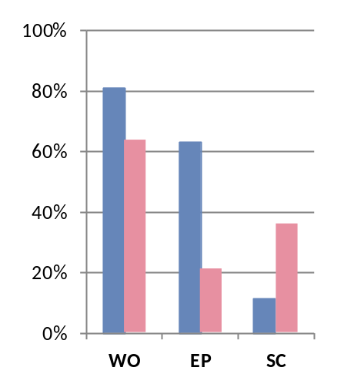
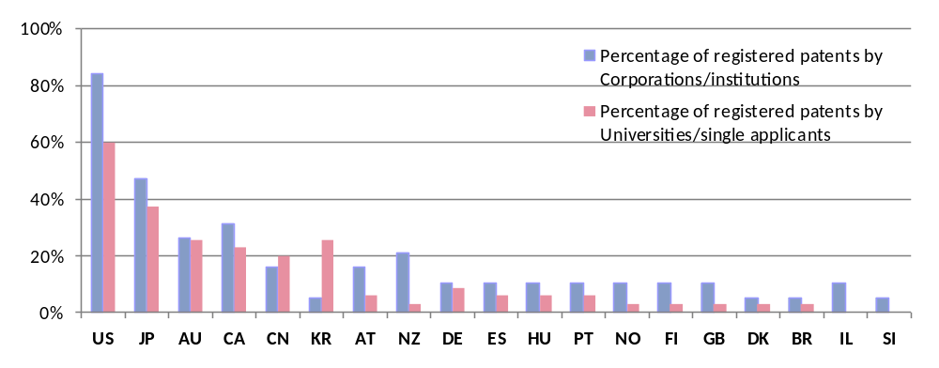
03
Evaluation of the invention
Fourth Step: Summary of analysis can be used as basis for filing patent(s) as well as informing your patent nationalization strategy
Percentage breakdown of registered patents
Percentage of registered patents by class
Percentage of registered patents by country and applicant type
Worldwide and European patents were mainly registered by corporations and institutions.
Single applicants and universities especially protected their patents in single countries.
With the exception of Israel (IL) and Slovenia (SI), both corporations/ institutions and universities/ single applicants registered patents within the respective country.
The reason for this may be the number of patents filed by universities/ single applicants that apply in their home countries (research driven), whereas corporations/ institutions extend their application to prestige markets such as the USA and individual countries for their WO/ EP patents.
South Korea is notable for percentage of registered patents by universities/ single applicants over corporations. Indicates active academic research involving keratinocytes, drug screening and toxicity assay development.
WO: Worldwide patent, is adequate to PCT patent; EP: European patent ; SC: Single country application ; Abbreviations: Explanatory notes are attached in the appendix

Slide 17
03
Evaluation of the invention
Fourth Step: Summary of analysis can be used as basis for filing patent(s) as well as informing your patent nationalization strategy
Patent Internationalization decision making – conventional IP strategy
Step 1
File Patent Application
ES or EP
PCT Filing Deadline
Priority
EP, USA, WO
1
months 0
12
Australia, Canada, China, Japan, South Korea
Priority
2
(Priority Date)
Step 2
Decide on internationalization strategy
Priority
Austria, Brazil, Canada, Denmark, Finland, Germany, Great Britain, Hungary, Israel, New Zealand
Important factors to consider:
Financial resources
Importance of markets
Potential customers or competitors
3
Priority Date :
The filing date of the patent application is considered the “priority date." When applying for protection in other countries, the filing date of the first application is considered to have “priority” over other applications. The period of priority in which a claimant can apply for subsequent countries is usually 12 months (priority year).
Once granted your invention will be protected in selected countries for a period of 17 – 20 years.
Source: WIPO, http://www.wipo.int/sme/en/faq/pat_faqs_q9.html

Slide 18
03
Evaluation of the invention
Fourth Step: Summary of analysis can be used as basis for filing patent(s) as well as informing your patent nationalization strategy
Patent Internationalization costs
Generalized Patent Internationalization Costs
Priority
Austria, Brazil, Canada, Denmark, Finland, Germany, Great Britain, Hungary, Israel, New Zealand
> 60,000 €
3
Priority
Australia, Canada, China, Japan, South Korea
2
20,000 €
Priority
+ EU, + USA, + PCT
Patent Costs €
1
File under ES or EP
6,000 €
Internationalization Strategy
Two starting options:
(1) Spanish Office of Patents and Trade Marks (OEPM)*
Must be in Spanish, extra costs for translation
Costs: 72€ filing fee + ca. 5000 € fee for Patent Attorney + translation costs + (optional) 250 € search fee
= ca. 5500 € + translation costs
(2) European Patent (EP)*
Must be in English
Costs: 200 € filing fee + 1165 € search fee + ca. 5000 € fee for Patent Attorney
= ca. 6500 €
Renewal fees (EPO for pending patent application) are due from the end of the second year*:
for the 3rd year 465 €
for the 4th year 580 €
for the 5th year 810 €
for the 6th year 1,040 €
for the 7th year 1,155 €
for the 8th year 1,265 €
for the 9th year 1,380 €
for the 10th year + subsequent yrs. 1,560 €
*much more costly for maintaining a granted European patent in a number of countries
* The total amount depends on the actual work load of the Patent Attorney and may exceed the mentioned amount
Source: EPO, http://www.epo.org/applying/forms-fees/fees.html

Slide 19
03
Evaluation of the invention
Fourth Step: Summary of analysis can be used as basis for filing patent(s) as well as informing your patent nationalization strategy
Patent Internationalization strategy & decision making – limited resources, maximum time
Step 1
ES
Patent Application
PCT Filing
EP Filing
Priority
EP, USA, WO
1
months 0
12
30
+1
Australia, Canada, China, Japan, South Korea
Priority
2
(Priority Date)
Step 2
Decide on internationalization strategy within 31 months
Priority
Austria, Brazil, Canada, Denmark, Finland, Germany, Great Britain, Hungary, Israel, New Zealand
Important factors to consider:
Financial resources
Importance of markets
Potential customers or competitors
3
Here we outline a patent application strategy which allows a longer time frame to decide on internationalization and defer costs
Compared to a conventional designation strategy (i.e. single country and/or EP, later followed by PCT), filing a PCT (world patent) during the first 12 month period allows a total of up to 30 months to determine countries for IP protection. This strategy takes advantage of the priority date and can defer costs.
Filing an EP patent by month 30 even allows an extra month to designate the EU countries for which patent is to be extended.
Once granted your invention will be protected in selected countries for a period of 17 – 20 years.
Source: WIPO, http://www.wipo.int/sme/en/faq/pat_faqs_q9.html

Slide 20
List of abbreviations
Abbreviation | Meaning
AT | Austria
AU | Australia
BR | Brazil
CA | Canada
CN | China
DE | Germany
DK | Denmark
EP | European Patent
EPO | European Patent Office
ES | Spain
FI | Finland
GB | Great Britain
HU | Hungary
IL | Israel
JP | Japan
KR | South-Korea
KR | South Korea
NO | Norway
NZ | New Zealand
PT | Portugal
SI | Slovenia
US | USA
WIPO | World Intellectual Property Organization
WO | Abbreviation for a PCT patent (valid worldwide)

